Slide 1
Virtual memory
I4GIC

Slide 2
What is virtual memory?
Virtual memory – separation of user logical memory from physical memory
● Only part of the program needs to be in memory for execution
● Logical address space can therefore be much larger than physical address space
● Allows address spaces to be shared by several processes
● Allows for more efficient process creation
● More programs running concurrently
● Less I/O needed to load or swap processes

Slide 3

What is virtual memory?
Virtual address space – logical view of how process is stored in memory
● Usually start at address 0, contiguous addresses until end of space
● Meanwhile, physical memory organized in page frames
● MMU must map logical to physical
Virtual memory can be implemented via:
● Demand paging
● Demand segmentation

Slide 4
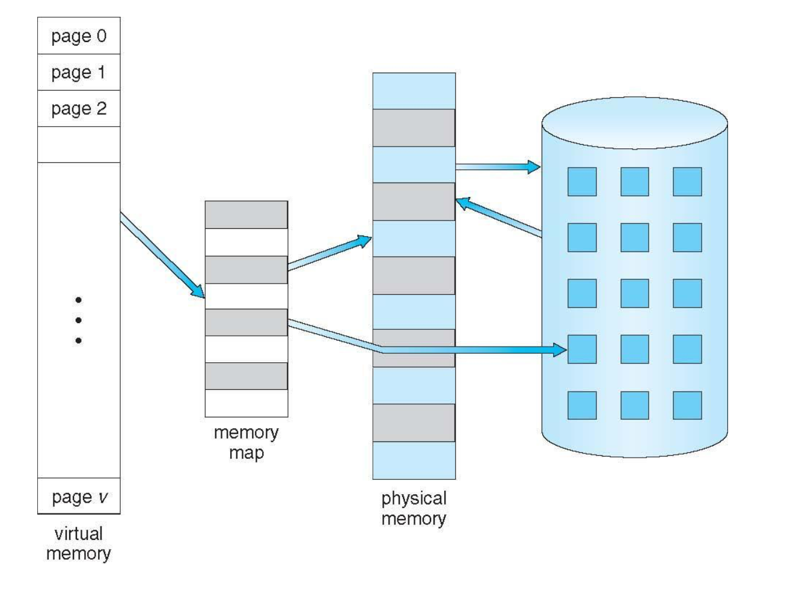
Virtual memory that is larger that physical memory

Slide 5
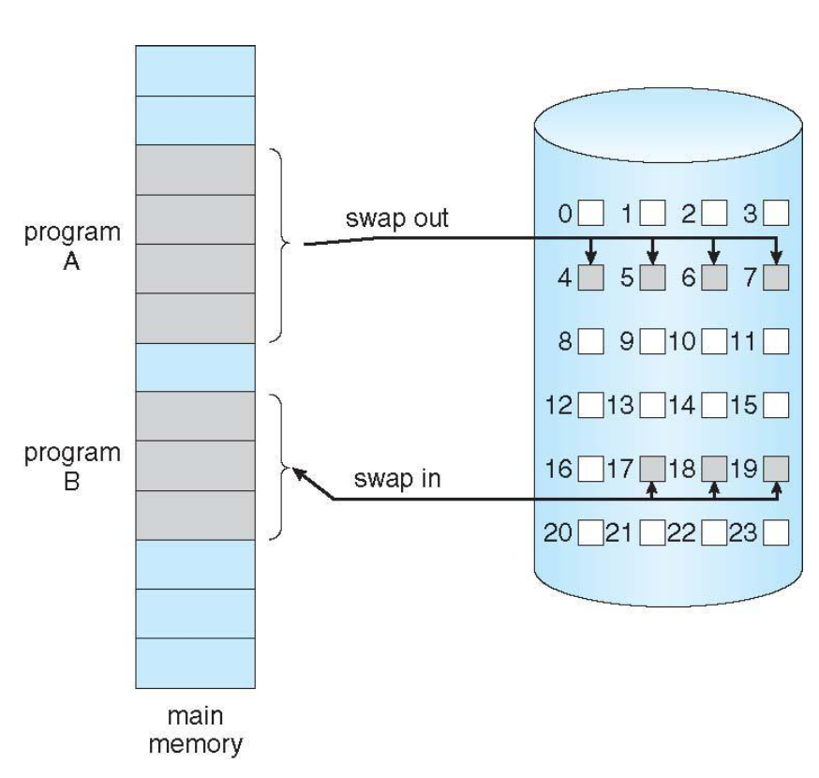
Demand paging
Could bring entire process into memory at load time
Or bring a page into memory only when it is needed
Less I/O needed, no unnecessary I/O
Less memory needed
Faster response
Similar to paging system with swapping (diagram on right)
Page is needed ⇒ reference to it
invalid reference ⇒ abort
not-in-memory ⇒ bring to memory
Lazy swapper – never swaps a page into memory unless page will be needed
Swapper that deals with pages is a pager

Slide 6
Demand paging
The virtual and physical memory are broken up into pages.
8KB page size
Virtual address
13
virtual page
number
page offset
Translated to physical
page number
Physical address

Slide 7
To access data at a given virtual address, the system performs the following steps:
Extract the page number from the virtual address.
Extract the offset from the virtual address.
Translate the page number into a physical page frame number by accessing the page table.
Look up the page number in the page table (using the virtual page number as an index).
Check the valid bit for that page.
If the valid bit = 0, the system generates a page fault and the operating system must intervene to
Locate the desired page on disk.
Find a free page frame (this may necessitate removing a “victim” page from memory and copying it back to disk if memory is full).
Copy the desired page into the free page frame in main memory.
Update the page table. (The virtual page just brought in must have its frame number and valid bit in the page table modified. If there was a “victim” page, its valid bit must be set to zero.)
Resume execution of the process causing the page fault, continuing to Step bii
If the valid bit = 1, the page is in memory
Replace the virtual page number with the actual frame number
Access data at offset in physical page frame by adding the offset to the frame number for the given virtual page

Slide 8
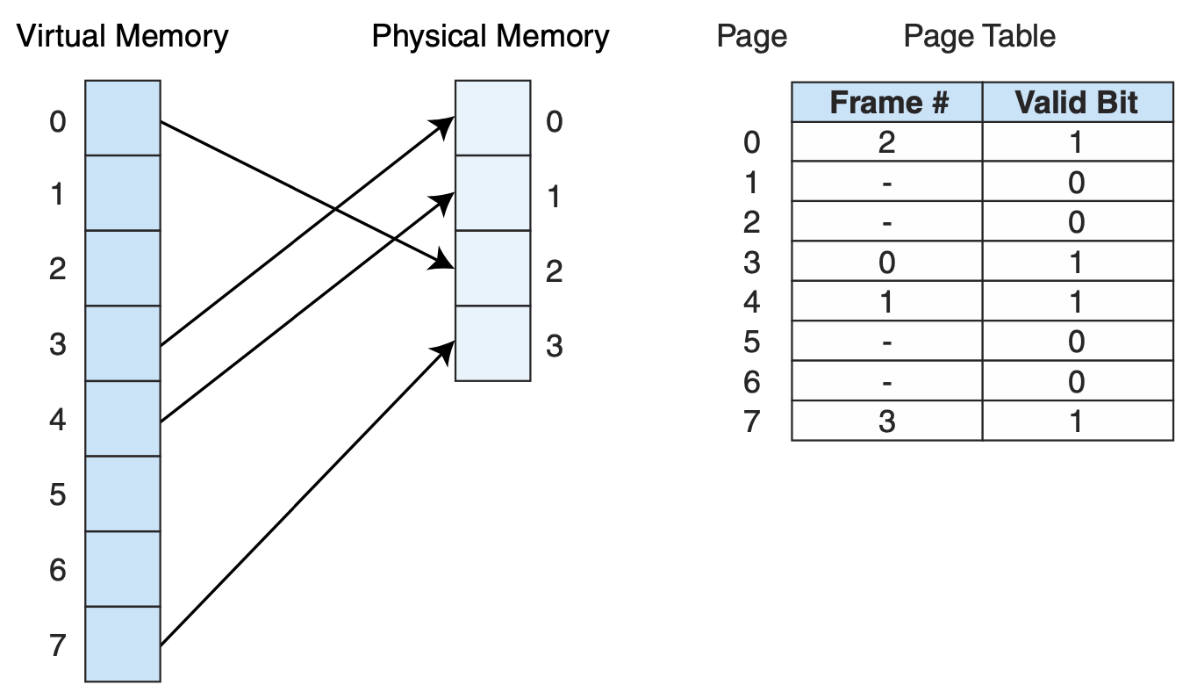
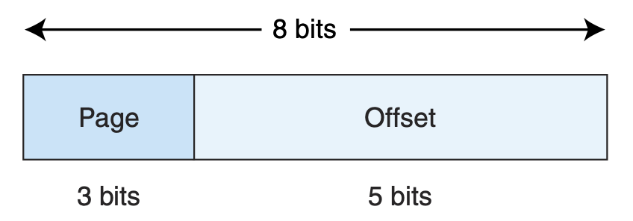
Example
Suppose that we have a virtual address space of 2⁸ words for a given process (this means the program generates addresses in the range 0 to 255₁₀ which is 00 to FF₁₆), and physical memory of 4 page frames (no cache). Assume also that pages are 32 words in length. Virtual addresses contain 8 bits, and physical addresses contain 7 bits (4 frames of 32 words each is 128 words, or 27). Suppose, also, that some pages from the process have been brought into main memory.

Slide 9
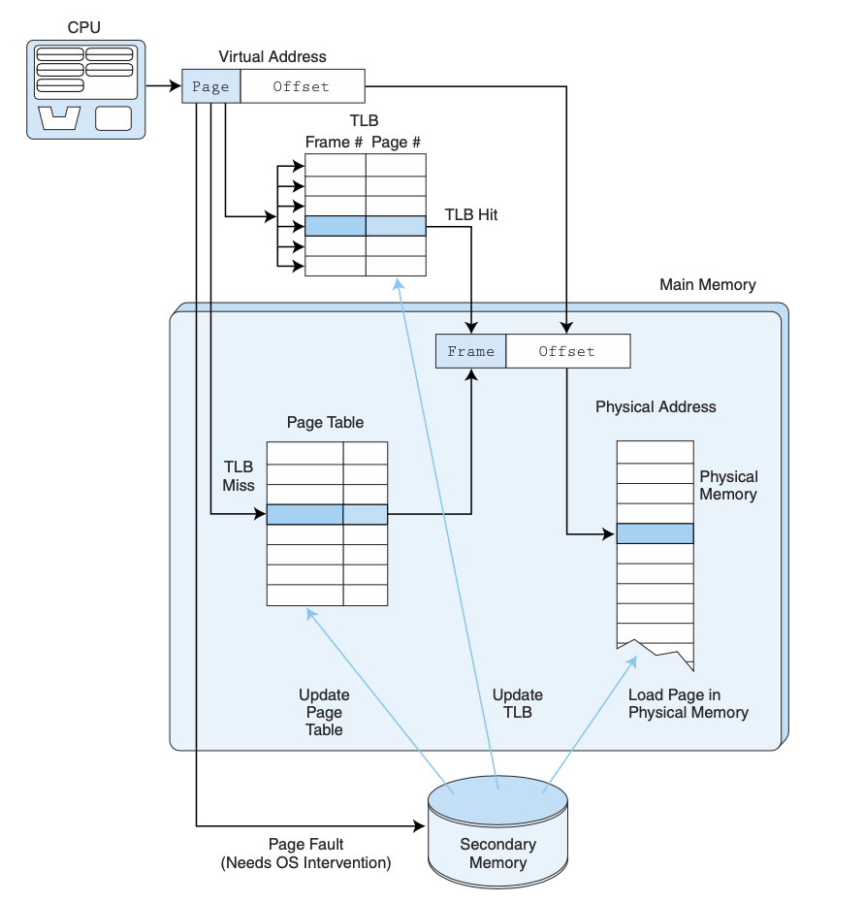
Include TLB

Slide 10
Page fault
If there is a reference to a page, first reference to that page will trap to operating system: page fault
Operating system looks at another table to decide:
Invalid reference ⇒ abort
Just not in memory
Find free frame
Swap page into frame via scheduled disk operation
Reset tables to indicate page now in memory Set validation bit = v
Restart the instruction that caused the page fault

Slide 11
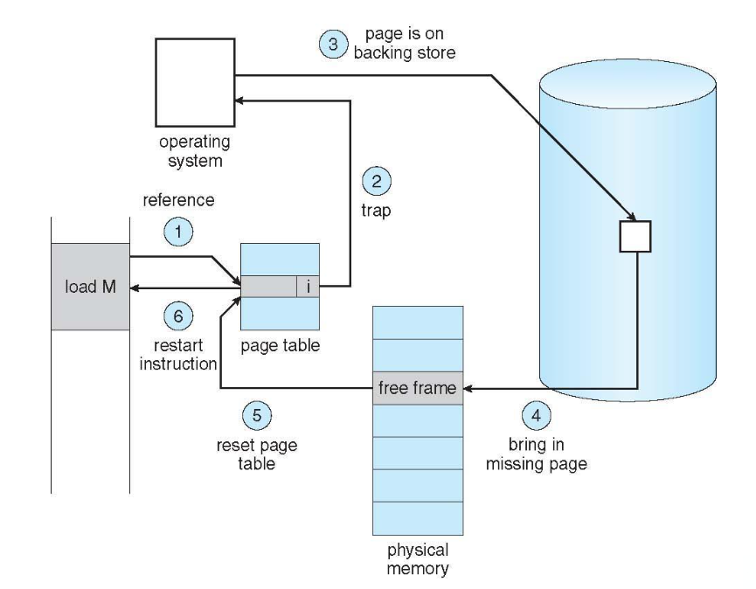
Steps in handling page fault

Slide 12
Aspects of demand paging
Extreme case – start process with no pages in memory
OS sets instruction pointer to first instruction of process, non-memory-resident => page fault
And for every other process pages on first access
Pure demand paging
Actually, a given instruction could access multiple pages => multiple page faults
Consider fetch and decode of instruction which adds 2 numbers from memory and stores result back to memory
Pain decreased because of locality of reference
Hardware support needed for demand paging
Page table with valid / invalid bit
Secondary memory (swap device with swap space)
Instruction restart

Slide 13
Performance of demand paging
Stages in demand paging (worse case)
Trap to the operating system
Save the user registers and process state
Determine that the interrupt was a page fault
Check that the page reference was legal and determine the location of the page on the disk
Issue a read from the disk to a free frame:
Wait in a queue for this device until the read request is serviced
Wait for the device seek and/or latency time
Begin the transfer of the page to a free frame
While waiting, allocate the CPU to some other user
Receive an interrupt from the disk I/O subsystem (I/O completed)
Save the registers and process state for the other user
Determine that the interrupt was from the disk
Correct the page table and other tables to show page is now in memory
Wait for the CPU to be allocated to this process again
Restore the user registers, process state, and new page table, and then resume the interrupted instruction

Slide 14
Performance of demand paging (Cont.)
Three major activities
Service the interrupt – careful coding means just several hundred instructions needed
Read the page – lots of time
Restart the process – again just a small amount of time
Page Fault Rate 0 ≤ p ≤ 1
if p = 0 no page faults
if p = 1, every reference is a fault
Effective Access Time (EAT)
EAT = (1 – p) x memory access + p (page fault overhead + swap page out + swap page in)

Slide 15
Example
Memory access time = 200 nanoseconds
Average page-fault service time = 8 milliseconds
EAT = (1 – p) x 200 + p (8 milliseconds)
If one access out of 1,000 causes a page fault, then EAT = 8.2 microseconds.
This is a slowdown by a factor of 40!!
If want performance degradation < 10 percent, we can have at most 1 page fault in every 400 000 memory accesses.

Slide 16
What happens if there is no free frame?
Used up by process pages
Also in demand from the kernel, I/O buffers, etc
How much to allocate to each?
Page replacement – find some page in memory, but not really in use, page it out
Algorithm – terminate? swap out? replace the page?
Performance – want an algorithm which will result in minimum number of page faults
Same page may be brought into memory several times

Slide 17
Page replacement
Prevent over-allocation of memory by modifying page-fault service routine to include page replacement
Use modify (dirty) bit to reduce overhead of page transfers – only modified pages are written to disk
Page replacement completes separation between logical memory and physical memory – large virtual memory can be provided on a smaller physical memory

Slide 18
Basic page replacement
Find the location of the desired page on disk
Find a free frame:
If there is a free frame, use it
If there is no free frame, use a page replacement algorithm to select a victim frame
Write victim frame to disk if dirty
Bring the desired page into the (newly) free frame; update the page and frame tables
Continue the process by restarting the instruction that caused the trap
Note now potentially 2 page transfers for page fault – increasing EAT

Slide 19
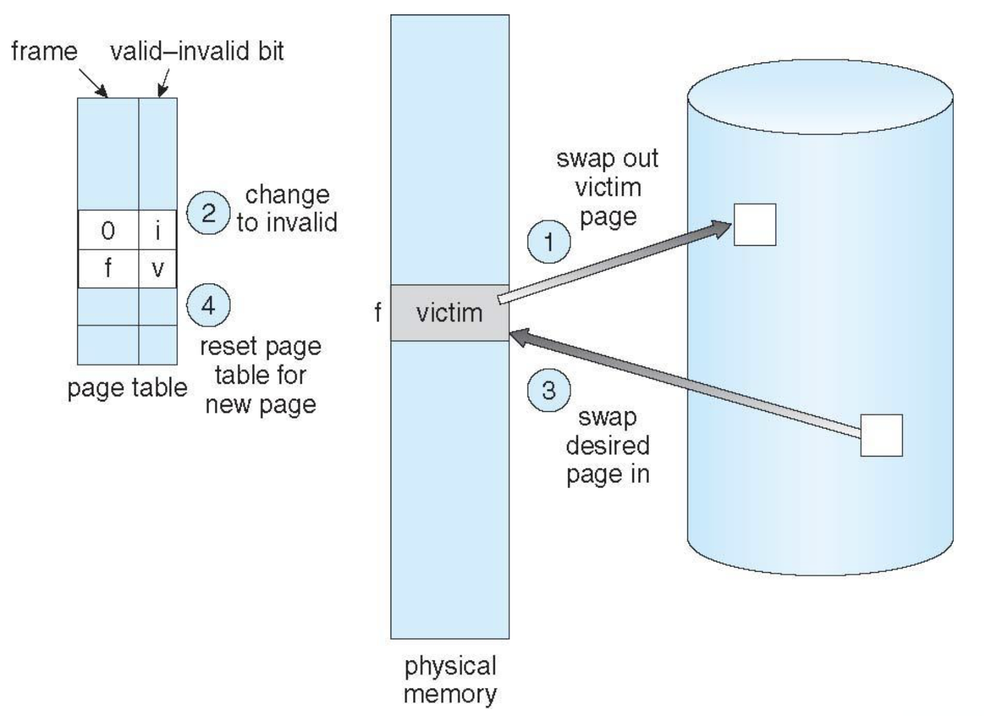

Slide 20
Page and frame replacement algorithms
Frame-allocation algorithm determines
How many frames to give each process
Which frames to replace
Page-replacement algorithm
Want lowest page-fault rate on both first access and re-access
Evaluate algorithm by running it on a particular string of memory references (reference string) and computing the number of page faults on that string
String is just page numbers, not full addresses
Repeated access to the same page does not cause a page fault
Results depend on number of frames available
In all our examples, the reference string of referenced page numbers is
7,0,1,2,0,3,0,4,2,3,0,3,0,3,2,1,2,0,1,7,0,1

Slide 21
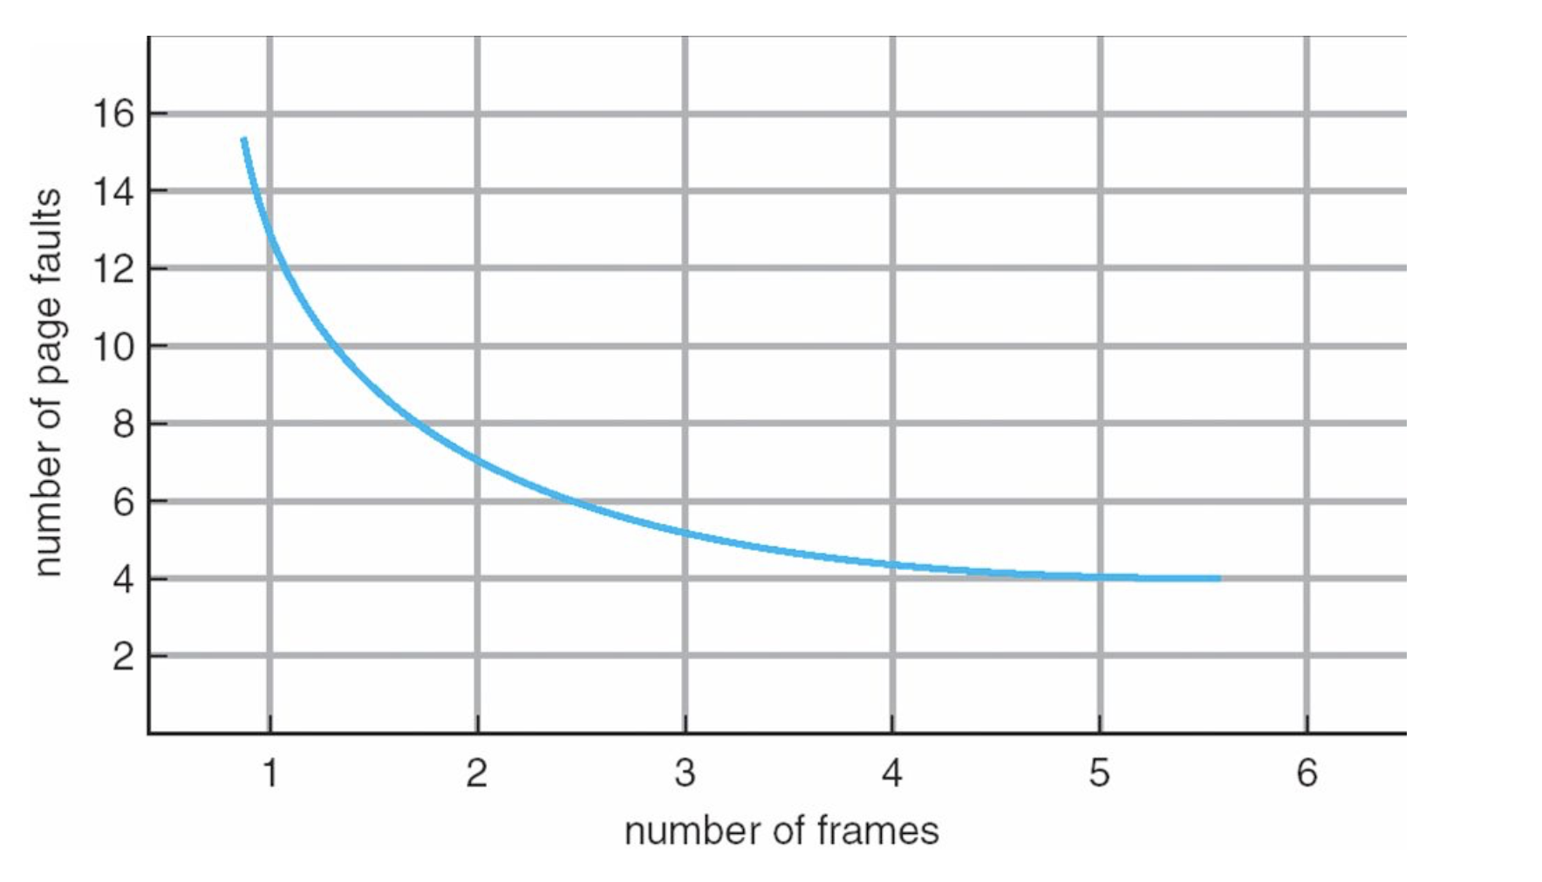
Graph of page faults versus the number of frames
The more frame you have, the less page faults occurs

Slide 22
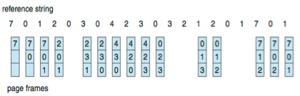
First-in-first-out (FIFO) algorithm
Reference string: 7,0,1,2,0,3,0,4,2,3,0,3,0,3,2,1,2,0,1,7,0,1
3 frames (3 pages can be in memory at a time per process)
15 page faults
Can vary by reference string: consider 1,2,3,4,1,2,5,1,2,3,4,5
Adding more frames can cause more page faults! (Belady’s Anomaly)

Slide 23
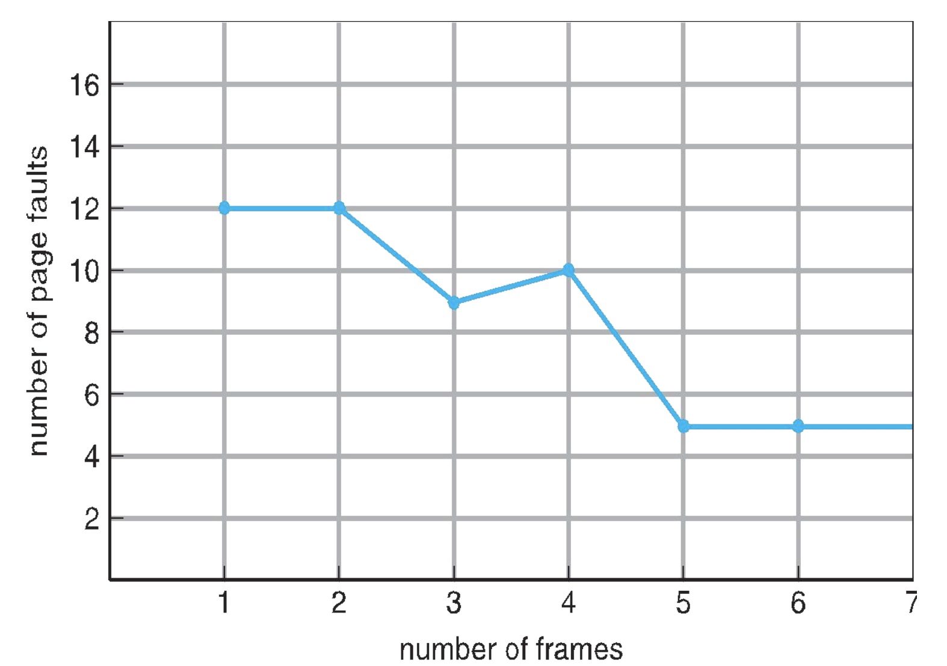
FIFO illustrating belady’s anomaly

Slide 24
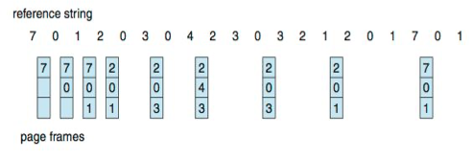
Optimal algorithm
Replace page that will not be used for longest period of time
9 is optimal for the example
How do you know this?
Can’t read the future
Used for measuring how well your algorithm performs

Slide 25
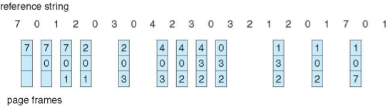
Least Recently used (LRU) algorithm
Use past knowledge rather than future
Replace page that has not been used in the most amount of time
Associate time of last use with each page
12 faults – better than FIFO but worse than OPT
Generally good algorithm and frequently used
But how to implement?

Slide 26
Least Recently used (LRU) algorithm
Counter implementation
Every page entry has a counter; every time page is referenced through this entry, copy the clock into the counter
When a page needs to be changed, look at the counters to find smallest value
Search through table needed
Stack implementation
Keep a stack of page numbers in a double link form:
Page referenced:
Move it to the top
Requires 6 pointers to be changed
But each update more expensive
No search for replacement
LRU and OPT are cases of stack algorithms that don’t have Belady’s Anomaly

Slide 27
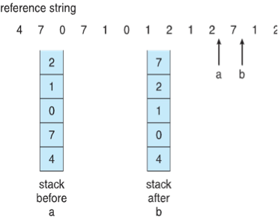
Use of a stack to record most recent page references

Slide 28
LRU Approximation algorithms
LRU needs special hardware and still slow
Reference bit
With each page associate a bit, initially = 0
When page is referenced bit set to 1
Replace any with reference bit = 0 (if one exists)
We do not know the order, however
Second chance algorithm
Generally FIFO, plus hardware-provided reference bit
Clock replacement
If page to be replaced has:
Reference bit = 0 => replace it
Reference bit = 1 then:
Set reference bit 0, leave page in memory
Replce next page, subject to same rules

Slide 29
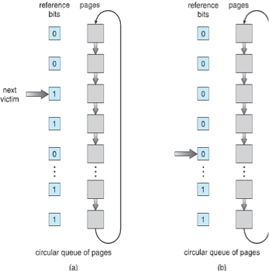
Second chance page replacement algorithm

